Slide 1
Poisson Distribution
(An example of Particular Discrete Probability Distribution)

Slide 2
What is Poisson distribution?
The Poisson distribution is a probability distribution used to model the number of events that occur within a fixed interval of time or space, given the events happen independently and at a constant average rate.
It is widely used in statistics to analyze rare events.

Slide 3
Key Characteristics of the Poisson Distribution
Discrete Distribution: It deals with counts (e.g., the number of occurrences of an event).
Single Parameter: Defined by λ (lambda), the average rate of occurrence within the interval.
Independence: Events occur independently of each other.
Fixed Interval: The interval (time, space, etc.) is pre-defined and does not vary.

Slide 4
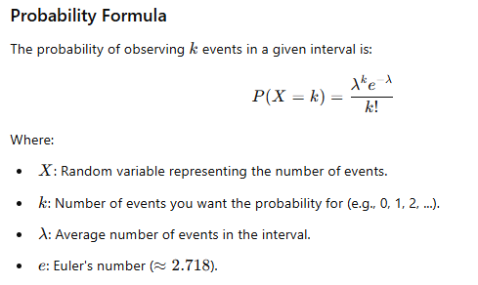

Slide 5
Analogy: Rain Droplets on a Car Window
Imagine you’re sitting in a car during a light drizzle. You wonder, "How many raindrops will hit the windshield in the next minute?" The raindrops:
Hit randomly and independently.
Have a certain average rate (e.g., 5 drops per minute).
This is a perfect scenario for the Poisson distribution. It can tell you the probability of receiving exactly 3 drops in the next minute, or no drops at all, given the average rate.

Slide 6
Real-Life Examples
1. Calls at a Call Center
A call center receives an average of 10 calls per hour (λ=10).
You can calculate the probability of receiving exactly 7 calls in the next hour using the Poisson formula.
2. Traffic Accidents
On a particular road, an average of 3 accidents occur per month (λ=3).
The Poisson distribution can be used to determine the probability of experiencing exactly 5 accidents in a month.
3. Email Arrivals
You receive an average of 2 emails per hour (λ=2).
The Poisson distribution helps calculate the probability of receiving exactly 4 emails in an hour.

Slide 7
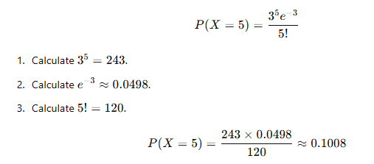
Example
Scenario: A bookstore sells 3 rare books on average per day (λ=3). What is the probability that exactly 5 rare books will be sold tomorrow?
Using the formula:
So, the probability is approximately 10.08%.

Slide 8
1. Poisson as a Model for Event Likelihood
The Poisson distribution is fundamentally a probabilistic model for discrete events in a fixed interval, assuming:
Events occur independently.
Events occur at a constant average rate (λ).
When we increase the interval (e.g., from 1 hour to 2 hours):
λ increases because the expected number of events scales with the interval.
Probabilities adjust, reflecting the fact that more events are now expected.

Slide 9
2. Impact of Time on Distribution
Shifting of Probabilities
As time increases:
Λ grows, and the distribution’s peak (most probable k) shifts to align with this new λ.
For larger λ, the probability mass (total probability of all outcomes) becomes more spread out, meaning smaller k values are less likely.
Broader Shape of the Distribution
The Poisson distribution becomes "wider" with higher λ, meaning:
The range of probable k values expands.
For small k, probabilities shrink because they are far from the new expected mean.
However, for k closer to λ, probabilities may increase.

Slide 10
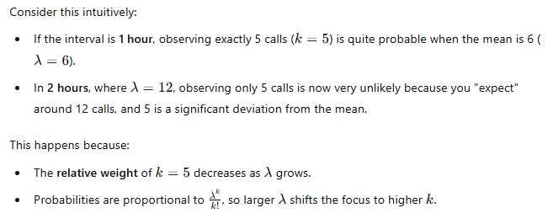
3. Why Fixed k Decreases?

Slide 11
Traffic Analogy
Suppose you’re monitoring cars passing a checkpoint:
On average, 6 cars/hour pass (λ=6).
Over 2 hours, the average increases to 12 cars (λ=12).
Now, the probability of observing exactly 5 cars in:
1 hour: Reasonable, since it’s close to the expectation of 6.
2 hours: Very unlikely, as you expect far more traffic.

Slide 12
Insights for Practical Applications
Call Center Context
In the call center example:
Over a longer period, the focus shifts from specific k values to ranges (e.g., 10–15 calls in 2 hours).
This highlights why businesses might prefer to calculate probabilities for ranges (P(X≥k) rather than exact counts.
Rare Events Modeling
For rare events (λ<1, such as system failures), the Poisson distribution emphasizes the likelihood of no events (P(X=0) and a few small k values. Increasing the interval can make rare events more probable, as λ grows.

Slide 13
Why Is "No Event" Important?
The "no event" scenario is important because it represents a baseline or starting point:
It shows the likelihood of nothing happening when you expect a certain average number of events to occur (λ).
It’s particularly useful when modeling rare events (e.g., accidents, failures, arrivals of calls) because it gives you insight into the chance that the event doesn’t happen at all during a given time.

Slide 14
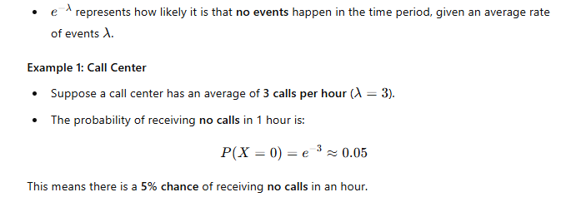
Meaning of "No Events" in Poisson Distribution
When we use the Poisson distribution to model the probability of zero events occurring:

Slide 15
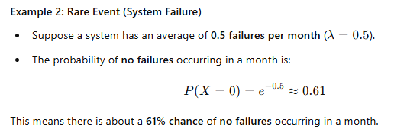

Slide 16
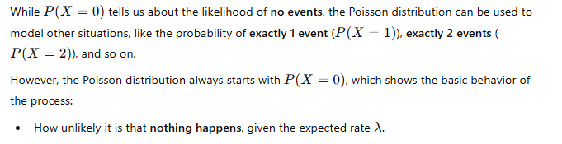
Link to the Larger Distribution (More than Zero Events)

Slide 17
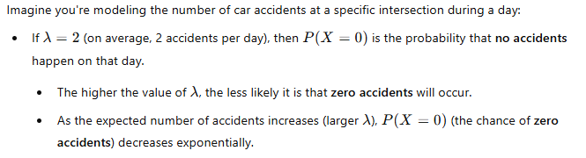
Real-World Scenario Analogy: Car Accidents

Slide 18
Example Question 1
Problem: A call center receives an average of 6 calls per hour. What is the probability that the call center will receive no calls in a given hour?

Slide 19
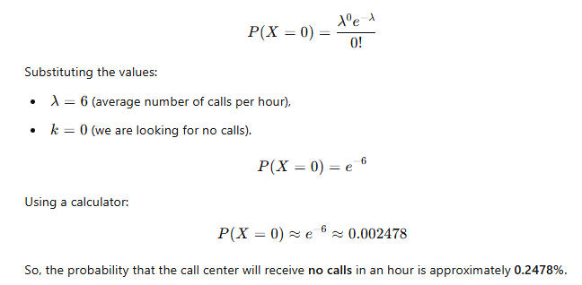
Solution:
We use the Poisson distribution formula to find the probability of receiving 0 calls:

Slide 20
Example Question 2
Problem: A hospital emergency room sees an average of 4 patients per hour. What is the probability that exactly 3 patients will arrive in 2 hours?

Slide 21
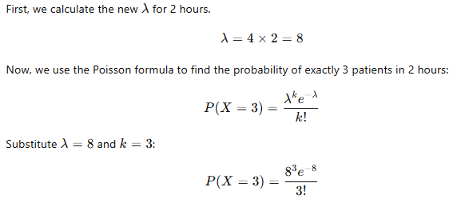
Solution

Slide 22
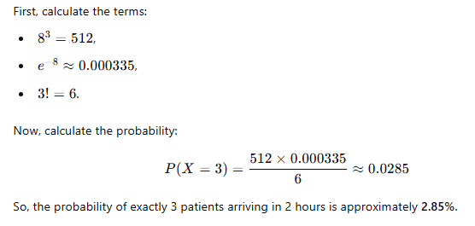

Slide 23
Example Question 3
Problem: A highway experiences an average of 2 traffic accidents per hour. What is the probability that there will be at least 4 accidents in a 3-hour period?

Slide 24
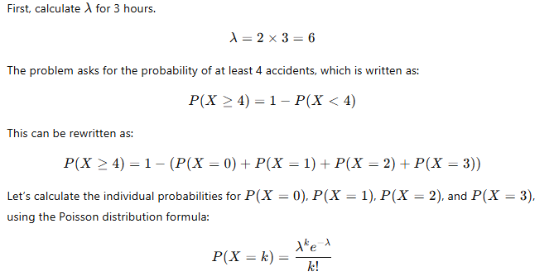
Solution

Slide 25
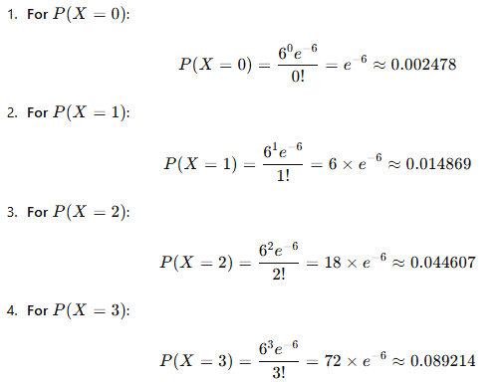
Where λ=6.
Now calculate each term:

Slide 26
